Slide 1

“Predicting students Dropout and Academic Success” Assignment #2
Big Data Fundamental Data Storage Networking – CBD 2214

Slide 2
Group 5 - Members
Aishlee - C0913045
Ashick Rijo - C0910364
Danilo Diaz - C0889539
Ernie Sumoso - C0881591 Yogita Sharma - C0913011

Slide 3
Dataset Description
This dataset called "Students' dropout and academic success" extracted from the UC Irvine Machine Learning Repository Archive.
Each row (instance) of the dataset is a different individual student. They may belong to different undergraduate degrees and programs.
we have 4424 rows and 37 features.
The features provided for each record are:
Marital Status: is the student married
Application mode: how did the student applied to their education program
Application order: application order of the student (0 - first choice; and 9 last choice)
Course: the student's program or course
Daytime/evening attendance: program schedule time
Previous qualification: student's previous education
Previous qualification (grade): student's previous grade
Nationality: country of origin
Mother's qualification: student's mother qualification
Father's qualification: student's father qualification
Mother's occupation: occupation of the student's mother

Slide 4
Dataset Description (contd.)
Father's occupation: occupation of the student's father
Admission grade: student's grade for the admission exam
Displaced: did the student had to displace from home
Educational special needs: student special education needs
Debtor: does the student has debts
Tuition fees up to date: is the student up to date with tuition fees
Gender: gender of the student
Scholarship holder: does the student holds an scholarship
Age at enrollment: student's age at the time of enrollment
International: is the student an international student
Curricular units 1st sem (credited): Number of curricular units credited in the 1st semester
Curricular units 1st sem (enrolled): Number of curricular units enrolled in the 1st semester
Curricular units 1st sem (evaluations): Number of evaluations to curricular units in the 1st semester
Curricular units 1st sem (approved): Number of curricular units approved in the 1st semester
Curricular units 1st sem (grade): Grade average in the 1st semester (between 0 and 20)
Curricular units 1st sem (without evaluations): Number of curricular units without evalutions in the 1st semester

Slide 5
Dataset Description (contd.)
Curricular units 2nd sem (credited): Number of curricular units credited in the 2nd semester
Curricular units 2nd sem (enrolled): Number of curricular units enrolled in the 2nd semester
Curricular units 2nd sem (evaluations): Number of evaluations to curricular units in the 2nd semester
Curricular units 2nd sem (approved): Number of curricular units approved in the 2nd semester
Curricular units 2nd sem (grade): Grade average in the 2nd semester (between 0 and 20)
Curricular units 2nd sem (without evaluations): Number of curricular units without evalutions in the 2st semester
Unemployment rate: Unemployment rate (%) of the student's college country
Inflation rate: Inflation rate (%) in the student's college country
GDP: Gross Domestic Product in the student's college country
Target: Three category classification task (dropout, enrolled, and graduate) at the end of the normal duration of the course
We will perform a predictive analysis to determine whether a student will graduate, dropout or continue to be enrolled in college.

Slide 6

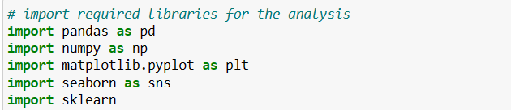
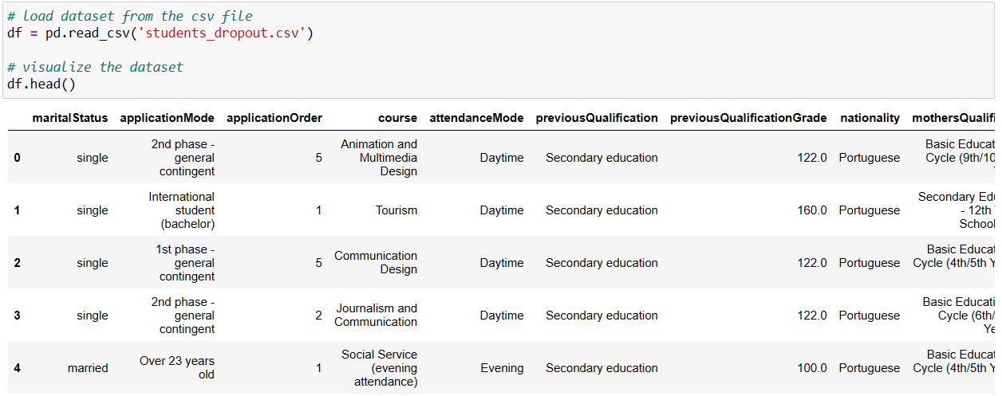
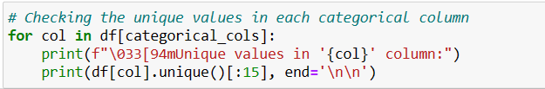
Data Acquisition and Filtering
03
Import the required libraries
Load the dataset
Checking the unique values for each column :
These missing values are filled as:
'nan’,
'Unknown', or
'(blank)'.

Slide 7
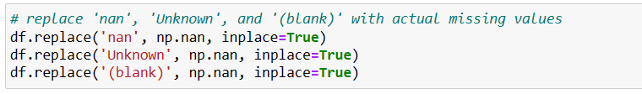
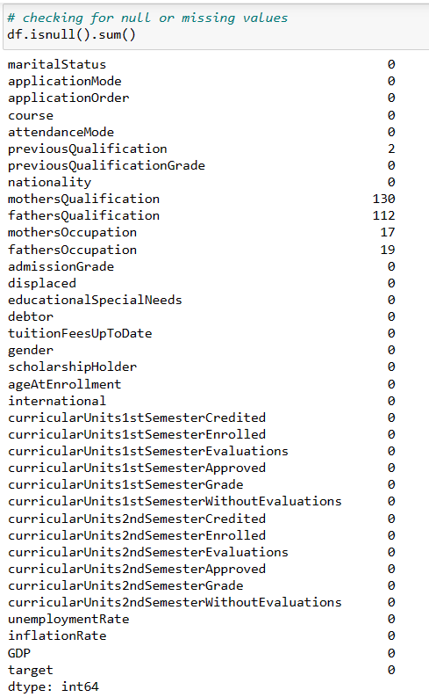
Let's handle these corrupted values
Replace the corrupted data with proper missing values using Numpy.nan
We have successfully replaced the corrupted data to count them as missing values

Slide 8
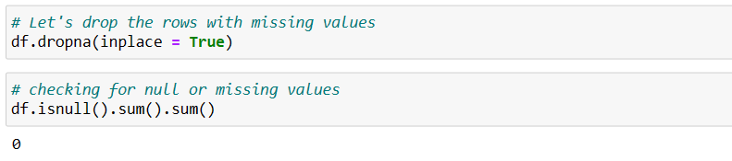
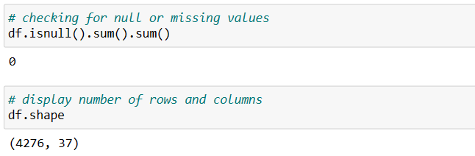
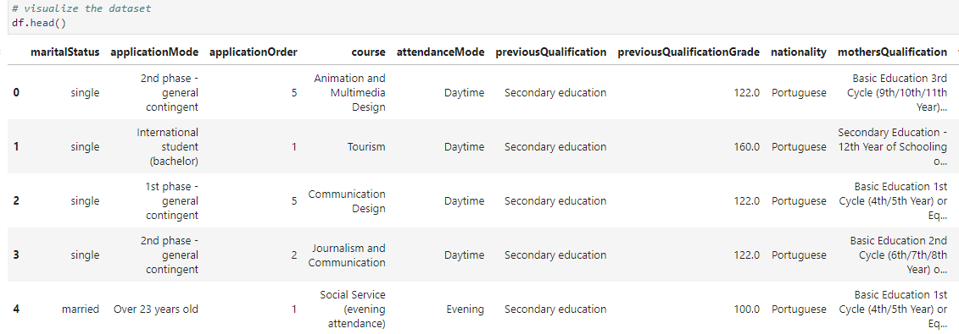
Drop the missing values (corrupted data)
Checking missing values again
We are left with 4276 rows (down from 4424)
Visualizing our dataset
As there are no more missing values, we have successfully acquired and filtered the corrupted data.

Slide 9

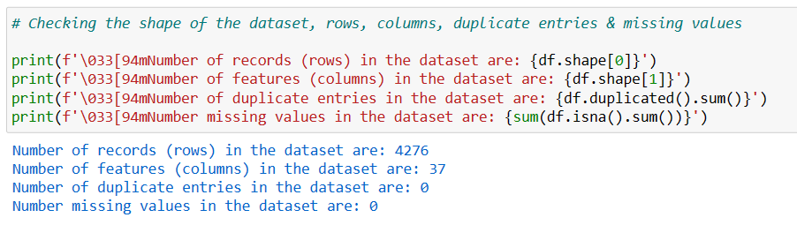
Data Extraction
04
On this stage, we extract disparate data and
transform it into a usable format for the analysis.
In this case, we need all the data in a structured tabular format.

Slide 10

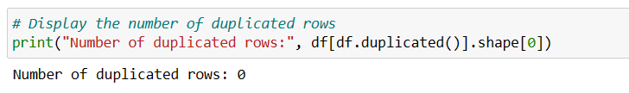
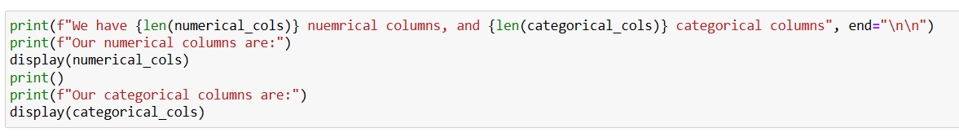
Data Validation and Cleansing
05
In this stage, we establish complex validation rules and apply them on our dataset to remove invalid data.
Identifying duplicated rows:
Identifying our numerical and categorical variables

Slide 11
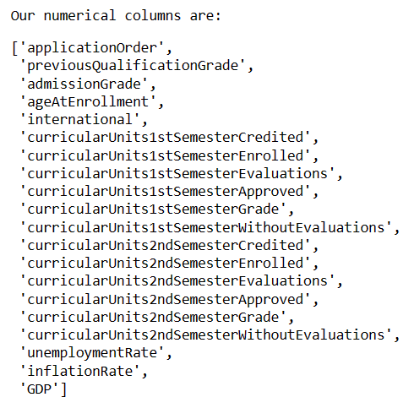
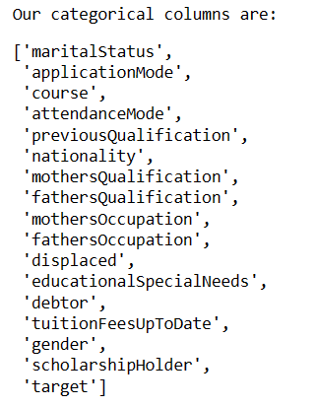
We have 20 numerical columns, and 17 categorical columns.

Slide 12
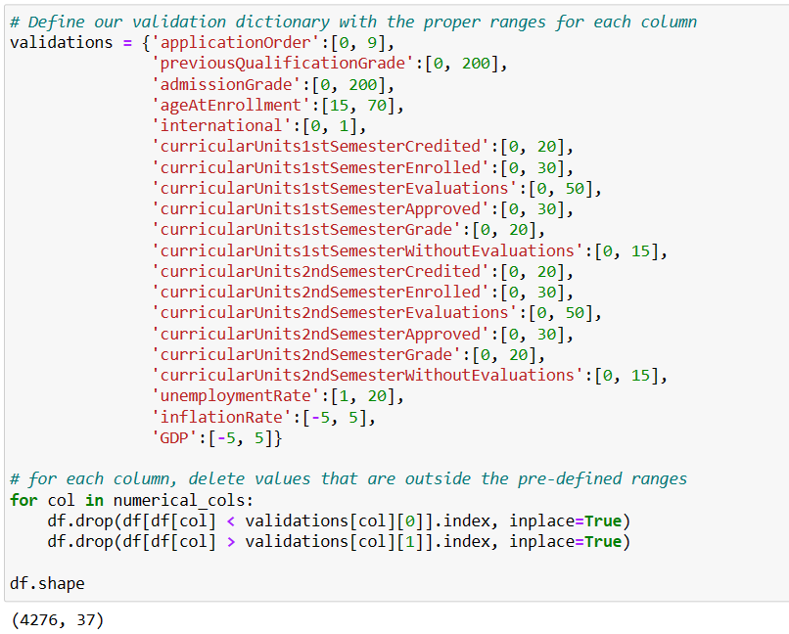
Performing a string validation on our categorical columns
Delete leading and tailing white spaces.
Performing a range validation on our numerical columns
Delete values outside the pre-defined ranges.

Slide 13

Data Aggregation and Representation
06
We can proceed to integrate our datasets
together into a unified view.
However, we’re working with only one dataset
gathered from a single source.
So, there is no need to perform further aggregation or representation steps.
If we had 2+ datasets, we would have to integrate them together into a single unified view using a common field among the different datasets.

Slide 14

Data Analysis
07
In this stage, we will predict if a student will dropout, graduate, or continue to be enrolled based on our predictive variables.
For our data analysis, we had performed the next steps:
7.1 Target variable exploration
7.2 Numerical variables exploration
7.3 Handling Outliers
7.4 Correlation between variables
7.5 Standard Scaling, Label encoding, and One-Hot encoding
7.6 Splitting the data - Test & Train datasets
7.7 Modelling
7.8 Cross-Validation
7.9 K-means clustering (Elbow method)

Slide 15

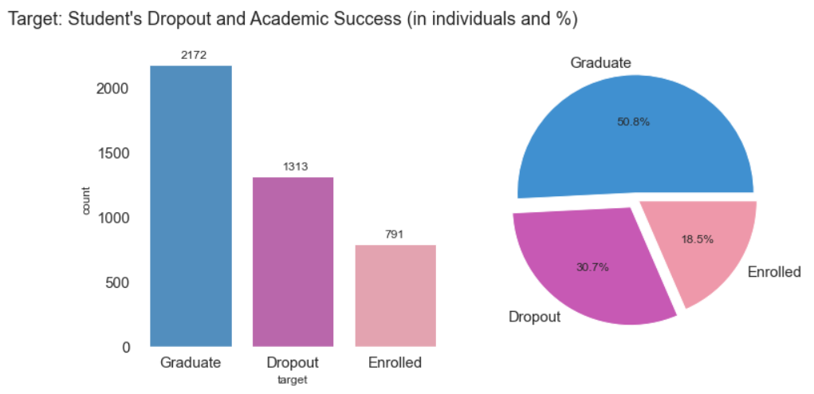
7.1 Target variable exploration Target variable explor
The possible values for our target are Graduate, Dropout and Enrolled
We can notice that our target values are imbalanced as 50% of students have graduated,
30% have dropout and 18.5% are enrolled.

Slide 16
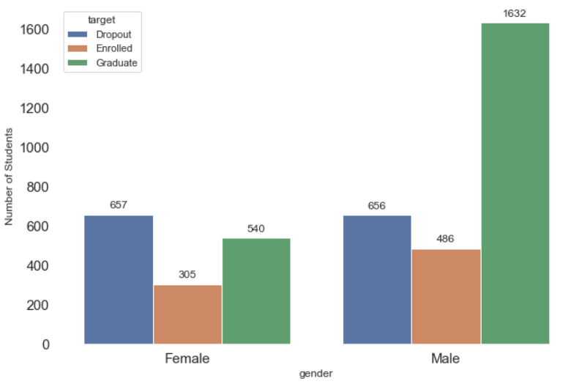
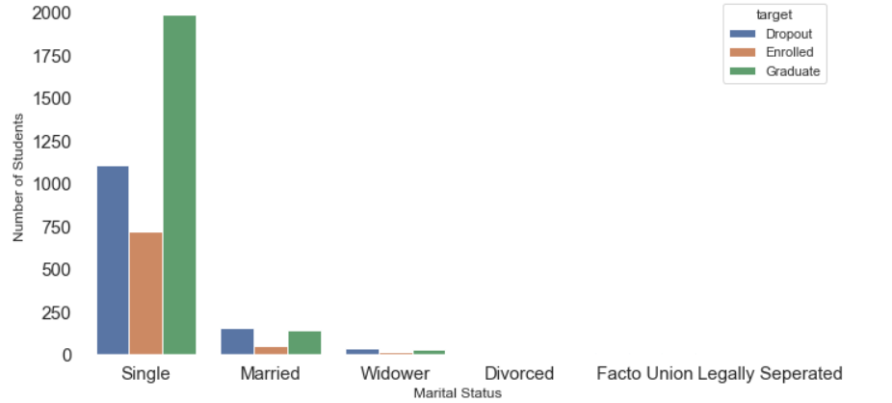
According to the data, a higher number of graduates are male, and both genders have similar dropouts, although males have higher enrolled students.
The majority of students are single or married.
However, single students have a higher chance of graduation, while married students have a higher chance of dropouts.

Slide 17

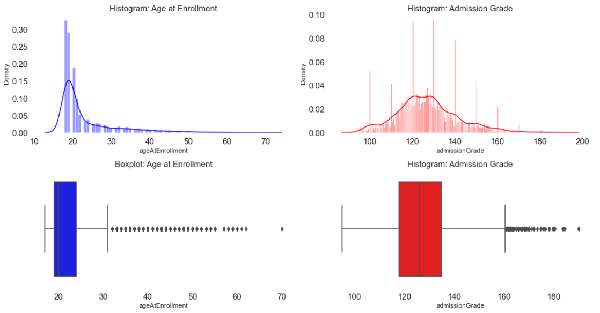
7.2 Numerical Variables Exploration
Plot histograms, boxplots to understand the distribution of our numerical variables and identify outliers.
Age at Enrollment:
The distribution of age at enrolment is positively skewed, indicating that the majority of students enrolled at a relatively young age.
The mean age at enrolment is approximately 23 years old, with the most frequent age range falling between 19 to 25 years old.
There are some outliers of people that enrolled after 40.
Admission Grade:
The distribution follows a normal distribution, with most grades around 120 and 130.
There are many outliers of students with outstanding grades over 160.

Slide 18
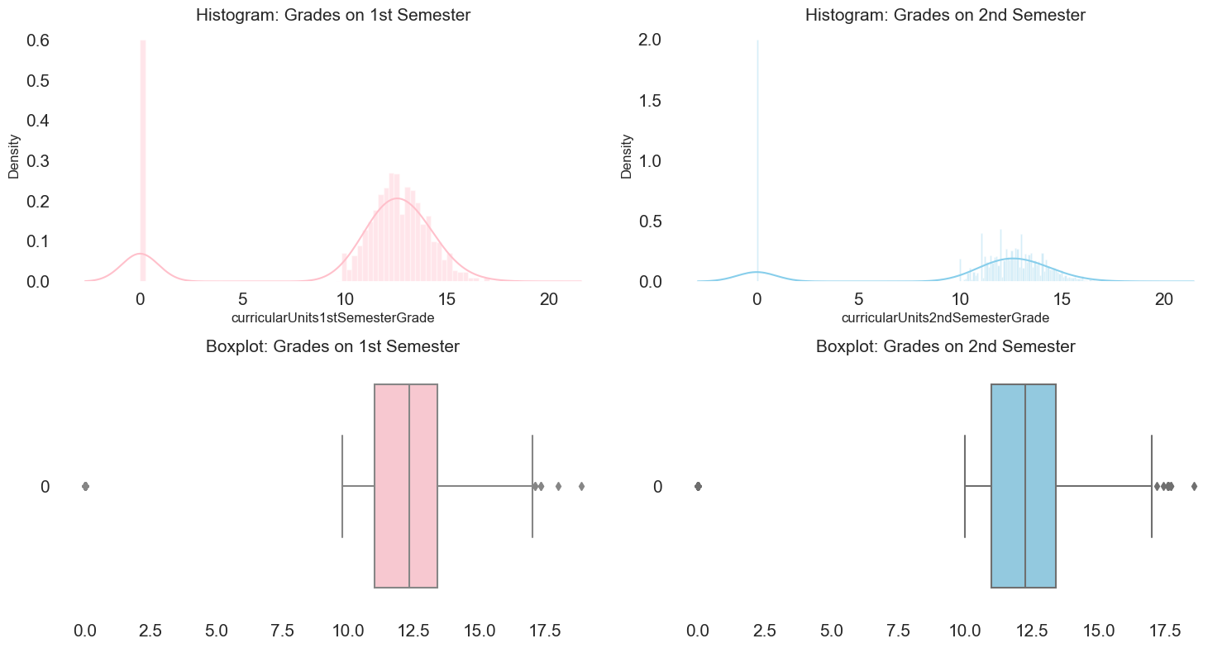
Grades on 1st Semester vs 2nd Semester:
For both semesters we have multiple outliers with zero value (grades).
Both semesters show a student performance grades near 12.5. However, 2nd semester has less data points.
Most of grades fall between 10 and 15 for both semesters.
There are very few positive outliers with grades over 17.5.

Slide 19
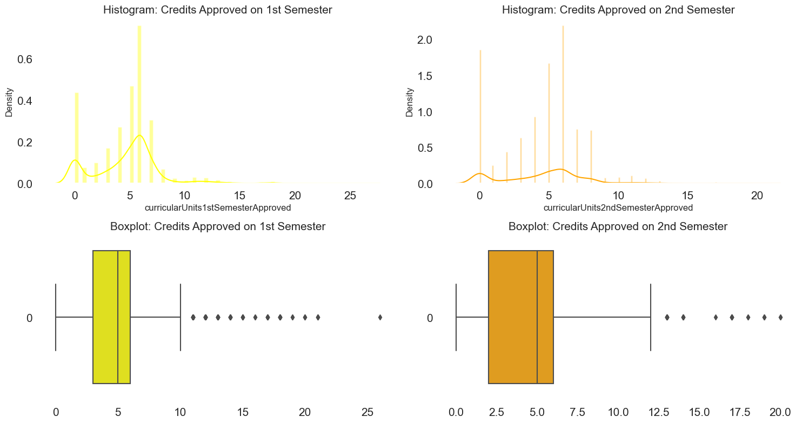
Observations, Credits approved on 1st Semester vs 2nd Semester:
For both semesters, the number of credits approved are around 5 and 6.
The distribution between both semesters remain somewhat similar.
Once again, we have plenty of zero values for both semesters, these are outliers.
There are few extreme outliers with more than 18 credits approved on both semesters.

Slide 20
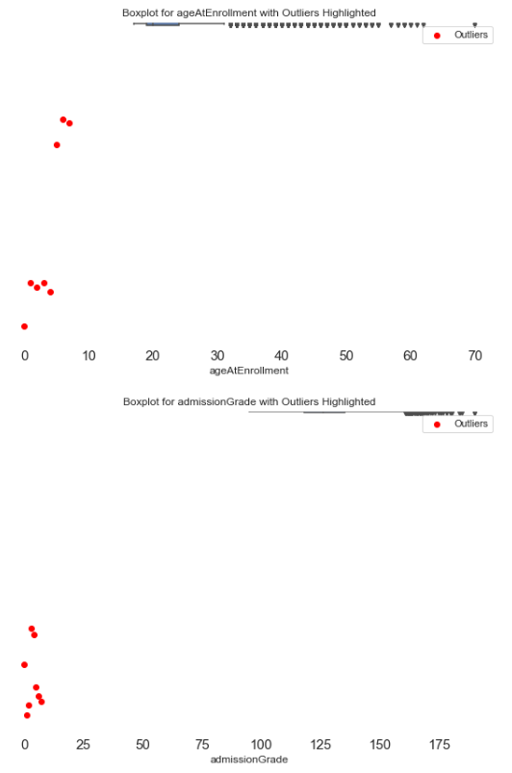
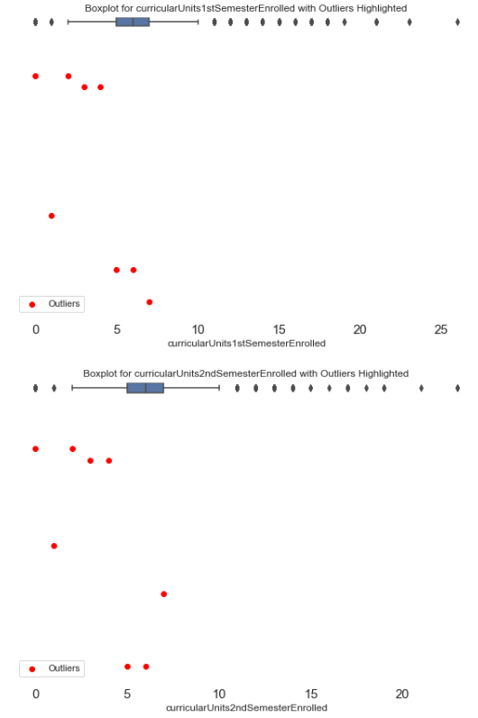
7.3 Handling Outliers
To detect outliers we find values that rely outside the Interquartile Range (IQR) which is defined as the 3rd Quantile - 1st Quantile.

Slide 21
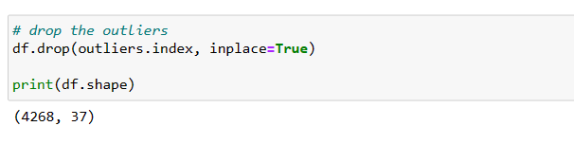
As we have properly identified outliers in our numerical columns.
Let's drop the corresponding rows containing outliers because they are few data compared to our dataset.
We have identified 8 outliers, let's drop these rows.
We are left with 4268 rows.

Slide 22

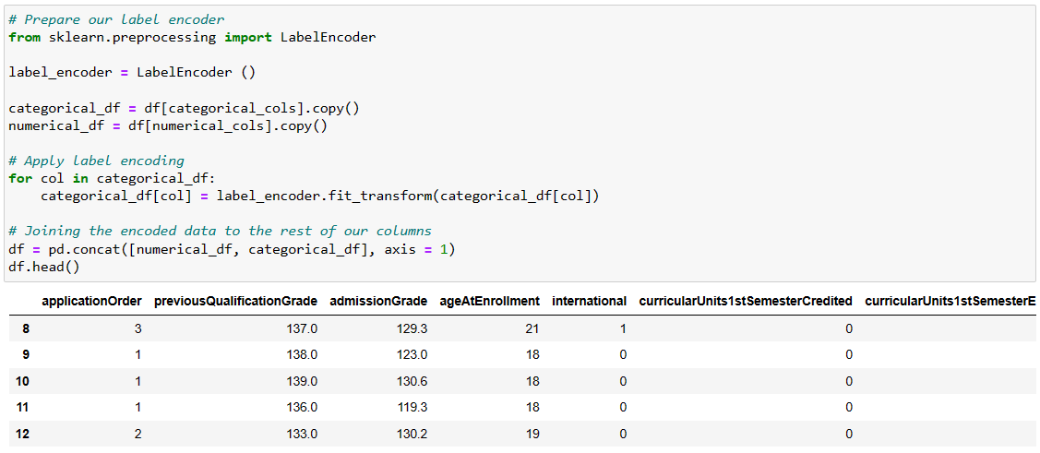
7.4 Standard Scaling, Label encoding, and One-Hot encoding
Apply label encoding on our nominal categorical variables

Slide 23
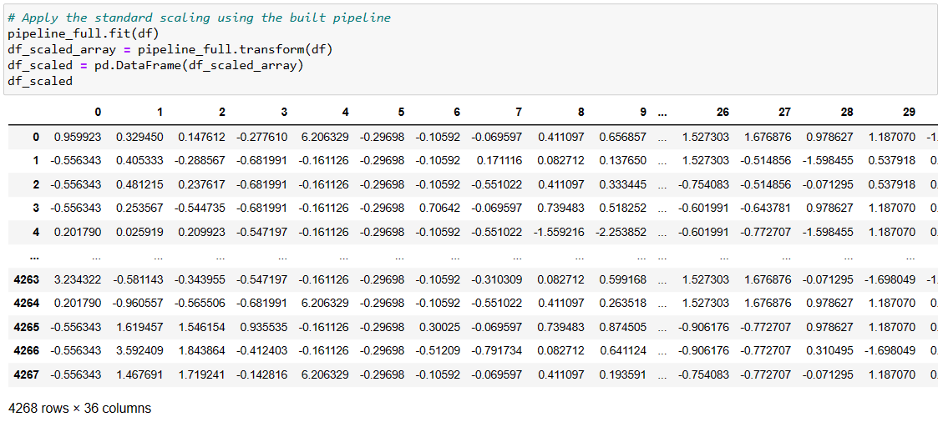
Apply standard scaling on our numerical variables

Slide 24
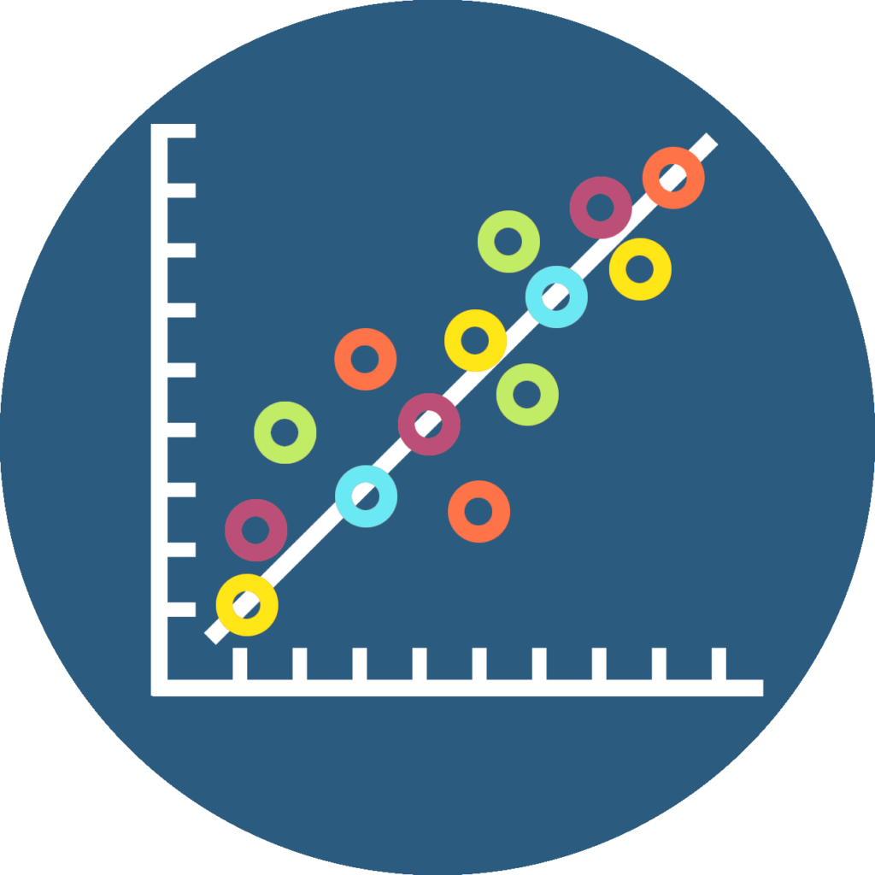
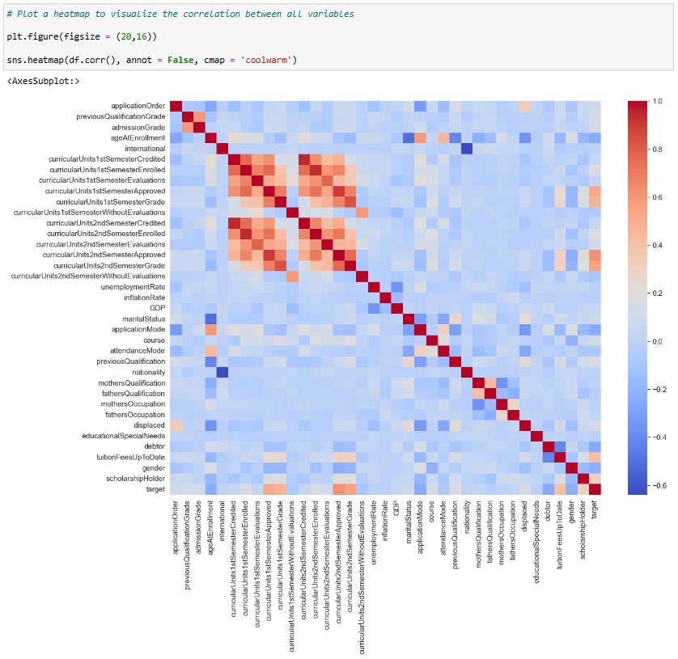
7.5 Correlation between variables
Plot a heatmap to visualize the correlation between our predictive variables and our target.

Slide 25
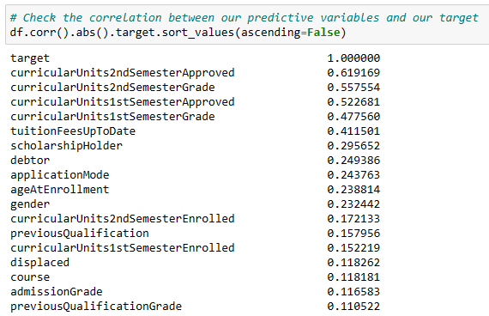
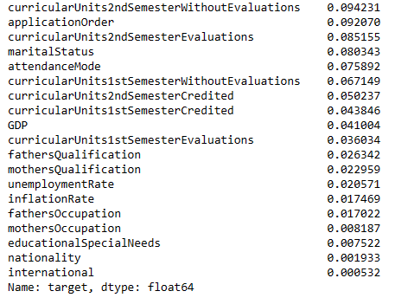
Calculate the correlation coefficient between all variables and our target
The most correlated variables to our target are: curricularUnits2ndSemesterApproved, curricularUnits2ndSemesterGrade, and curricularUnits1stSemesterApproved
The lowest correlated variables to our target are: nationality, international, educationalSpecialNeeds, and the parents occupations.

Slide 26

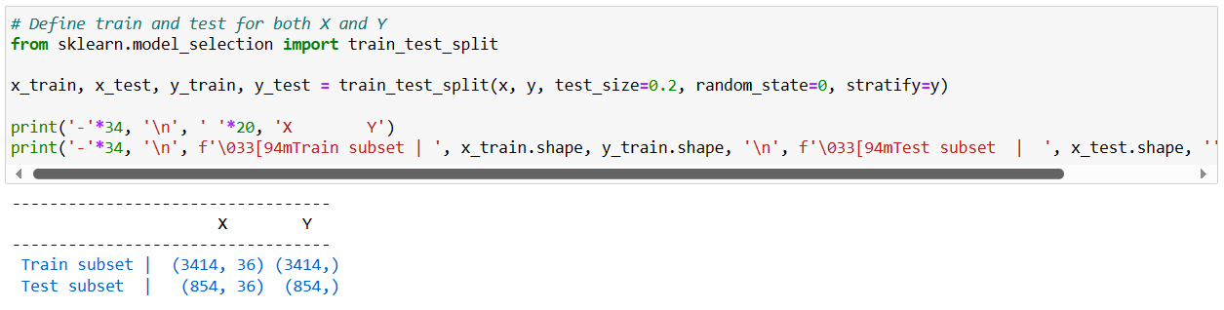
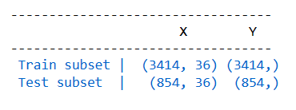
7.6 Splitting the data - Test & Train datasets
Split our dataset into train and test subsets following an 80% - 20% ratio.
This will allow us to train different machine learning algorithms.

Slide 27

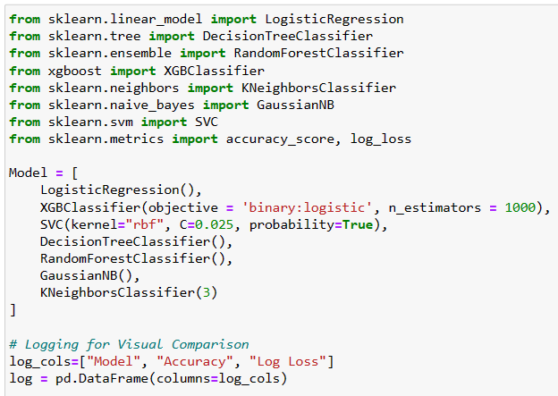
7.7 Modelling
To predict students' academic success and dropouts, we will use multiple classification models (from sklearn) to determine the target variable:
Logistic Regression
Extreme Gradient Boosting (XGBoost)
Support Vector Machine (SVC)
Decision Tree Classifier
RandomForestClassifier
Gaussian Naive Bayes (GaussianNB)
KNeighborsClassifier

Slide 28
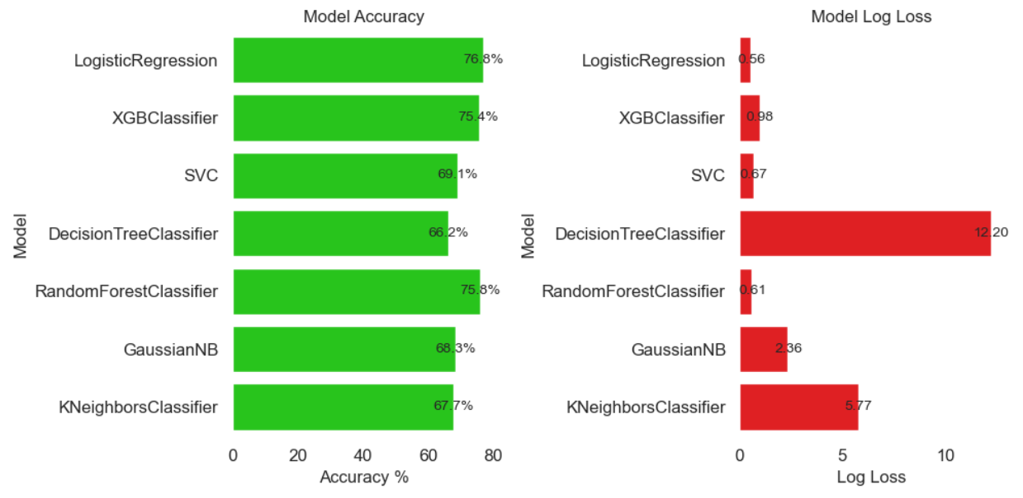
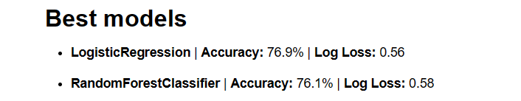
Visualizing the accuracy & log loss from our models
WHY choosing these models ?
- They present the best accuracy and least logarithmic loss
among our tested models
- Both are suitable for tabular datasets to perform classification in predictive model problems.

Slide 29

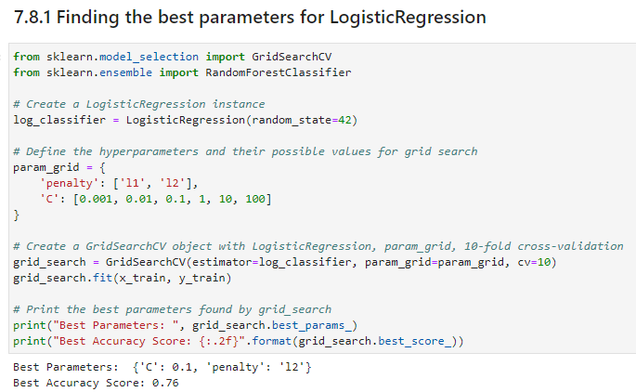
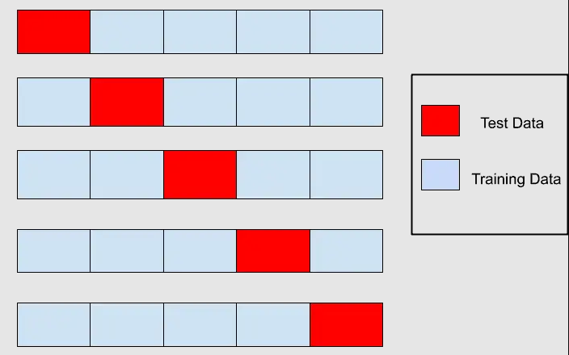
7.8 Cross Validation
Must perform cross validation to discard overfitting in our models
Most important, we used Cross Validation to find the best parameters for both our models.
Randomly split our test & train datasets multiple times, evaluate and compare results

Slide 30




Best parameters for our Logistic Regression model
With these parameters we predict our target values again and find our new enhanced accuracy.
Best parameters for our Random Forest Classifier

Slide 31
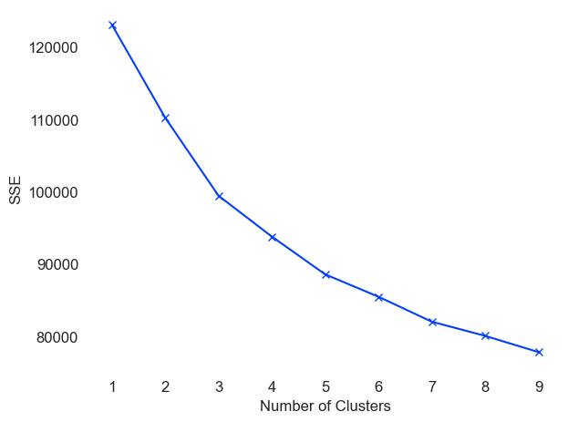
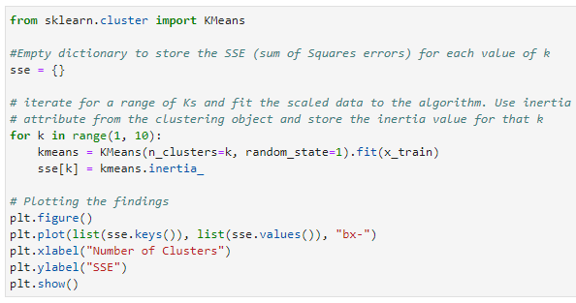
7.9 K-means clustering (Elbow method)
The elbow method is a graphical method for finding the optimal K value in a k-means clustering algorithm.
This method involves plotting the cost function's values generated by various K values, where potential choices for the cluster count might be 3 or 4. We are specifically interested in 3 clusters (K=3) because we are aware that there are 3 possible outcomes for the target.

Slide 32
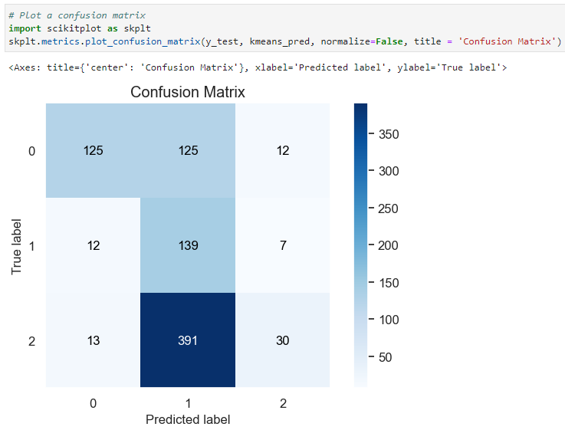
Results of K-means clustering
To visualize the results, we can plot a confusion matrix for this classification problem.

Slide 33

Data Visualization
08
On this stage, we communicate the results to our business users using graphics and receive feedback from them.
Now, we have a trained model, we can visualize our results by plotting a confusion matrix, and ROC curve.
Confusion matrix: comparing and visualizing true labels vs predicted labels
ROC curve: visualizing the performance of our model
Possible values for our target variable:
0: Dropout
1: Enrolled
2: Graduate

Slide 34
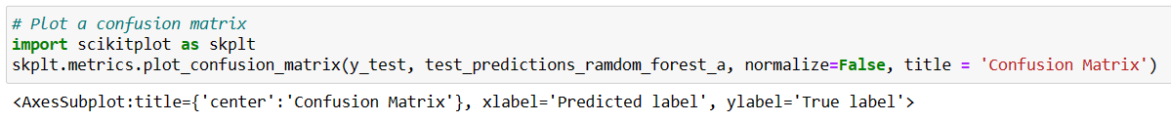
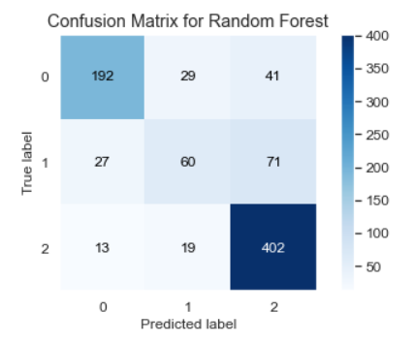

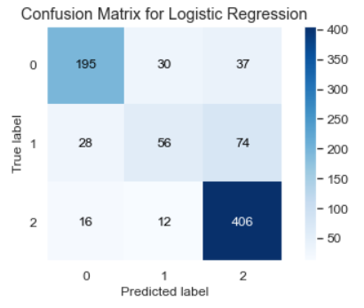
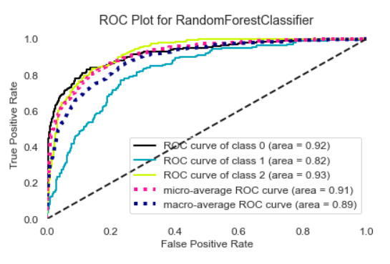
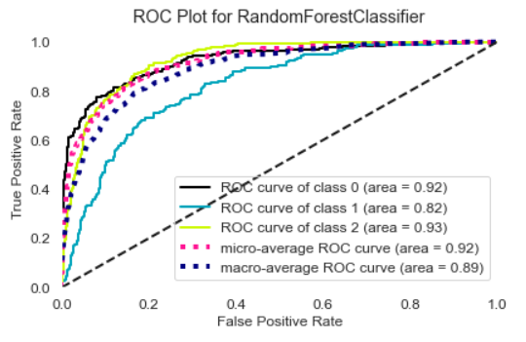

Slide 35

Conclusions
09
Our results indicate that a student success is more likely to depend on themselves rather than external factors. As the most influential variables were their grades and credits approved on 1st and 2nd semesters.
For educational institutions, our results could mean that they should focus their efforts on the student's performance and well-being.
For example, they could include more mental health workshops, or extra office hours for some subjects to boost their performance.
Both our best models had rough time predicting the label "Enrolled" (which are neither graduates or dropouts, but students that are taking longer than expected to finish their programs).
More than half enrolled students were predicted incorrectly.
Therefore, we conclude that there is not enough data to properly predict "Enrolled" students, as only 18.5% our data was labeled with this value.
However, for dropouts and graduates, our model did an excellent job predicting true labels:
75% of dropouts were predicted succesfully
93% of graduates were predicted succesfully

Slide 36
9. References
Dataset: Predict students' dropout and academic success
https://archive.ics.uci.edu/dataset/697/predict+students+dropout+and+academic+success
EDA and Prediction of Student Academic Success
https://www.kaggle.com/code/paulandrewpaglinawan/eda-and-prediction-of-student-academic-success
XGBoost official documentation
https://xgboost.readthedocs.io/en/stable/parameter.html
Sci-kit: Supervised learning models documentation
https://scikit-learn.org/stable/supervised_learning.html#supervised-learning
Sci-kit plot: documentation for data visualization using confussion matrix and ROC Curves
https://scikit-learn.org/stable/modules/generated/sklearn.metrics.ConfusionMatrixDisplay.html

